Slide 1
Distributed Computer Systems
CT024-3-3-DCOMS and Version 0416
ICE

Slide 2
Topic & Structure of The Lesson
Introduction
About ICE
Setting up ICE
Slices
Starting with Java

Slide 3
Learning Outcomes
At the end of this topic, You should be able to
Understand the concept of ICE
How ICE will be used to support in DS
Identify the key factors of ICE
How to setting up the ICE

Slide 4
Key Terms You Must Be Able To Use
If you have mastered this topic, you should be able to use the following terms correctly in your assignments and exams:
ICE
Slices
Proxy
Modules

Slide 5
Introduction
The Internet Communications Engine, often simply referred to as ICE, is a platform enabling distributed computing. It’s both free and open source, and simple to get started with. Distributed computing is useful to delegate a large task to several machines, or even to a single machine better equipped to handle a task.
The ICE platform supports C++, Java, .NET, Python, Objective-C, and Javascript, and has partial support for Ruby and PHP. In this tutorial, you will learn how to begin using ICE.

Slide 6
About ICE
ICE claims to use a client-server model, but that is somewhat ill-deﬁned. A single machine need not exclusively be a server or a client in ICE. A machine A can connect as a client to a server machine B, and machine B can connect as a client to another server machine C. In fact, any machine can be connected as either a client or a server in a one-to-one, one-to-many, or many-to-many relationship.

Slide 7
Proxies
A client must have a proxy to connect with an ICE object. A proxy represents the ICE object to the client; when the client invokes a method on a proxy, it contacts the ICE object on the server application and invokes the method there.

Slide 8
Setting up ICE
Assume that your system runs Windows, and is conﬁgured with an up-to-date version of Java, as well as Oracle’s Eclipse IDE. To install ICE, download the Windows installer from www.zeroc.com/download.html and run it. Once completed, be sure to add the ICE compilers to your Windows PATH. At the time of writing, this path is
C:\Program Files\ZeroC\Ice-3.5.1\bin

Slide 9
Slices
Ice uses a slice to describe objects and methods. When compiled, a slice generates descriptions for the objects and methods into the supported languages.
This allows for consistency when writing code in diﬀerent languages, since the code is all generated from the same slice. The slice compiler will translate the slice deﬁnition into whatever implementation is correct for a given language.

Slide 10
Writing a Slice
A slice describes objects and methods in a language that’s best described as an amalgam of C++ and Java. A slice is required to have the case-sensitive .ice ﬁle extension. Below, we will discuss the slice syntax and provide an example of a basic slice.

Slide 11
Modules
A slice ﬁle must contain at least one module. A module can contain any legal slice constructs.
An example of module deﬁnitions can be seen below.
//a module definition module Foo{ //a nested module definition module Bar{ ... }; module Baz{ ... }; }; //a module can be reopened later, //in the same file, or another file. module Bar{ ... };

Slide 12
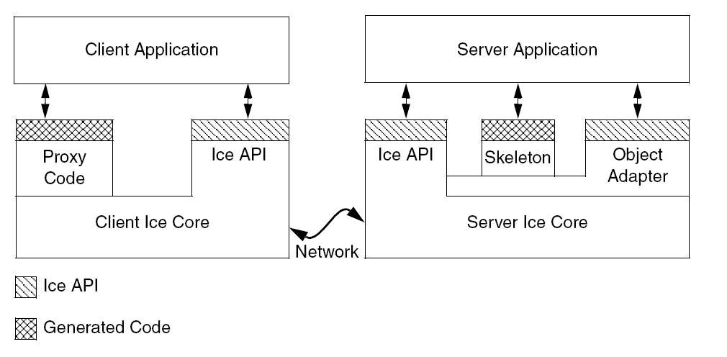
ICE Architecture

Slide 13
Basic types, enumerations, sequences and dictionaries
The Slice syntax supports several basic types, which you should already be familiar with. These types are bool, byte, short, int, long, ﬂoat, double, and string. It is important to note that the string type does not provide support for the null string concept.

Slide 14
Compiling a Slice
To compile a slice for Java, simply open up the Windows command prompt and enter
slice2java file.ice

Slide 15
Starting with Java
Create a new project in Eclipse called SorterExample. Add the ﬁle Ice.jar to your build path. This ﬁle can be found in the lib folder in the Ice directory in Program Files. Also, include all of the ﬁles generated from the slice in a package called SorterExample

Slide 16
Summary
ICE claims to use a client-server model, but that is somewhat ill-deﬁned.
A proxy represents the ICE object to the client.
Ice uses a slice to describe objects and methods. When compiled, a slice generates descriptions for the objects and methods into the supported languages.

Slide 17
Question and answer session
Q & A

Slide 18
What we will cover next
Grid, Virtualization and Cloud Computing

